Slide 1
Relational model Checkpoint
Meftah Jaafer

Slide 2
OBJECTIVES
INSTRUCTIONS
Relational DIAGRAM

Slide 3
OBJECTIVES
After the construction of his hotels in one of the tourist areas, a director wishes to prepare a database to facilitate the management of his data.
The director has presented the following information to you through the entity relationship model.

Slide 4
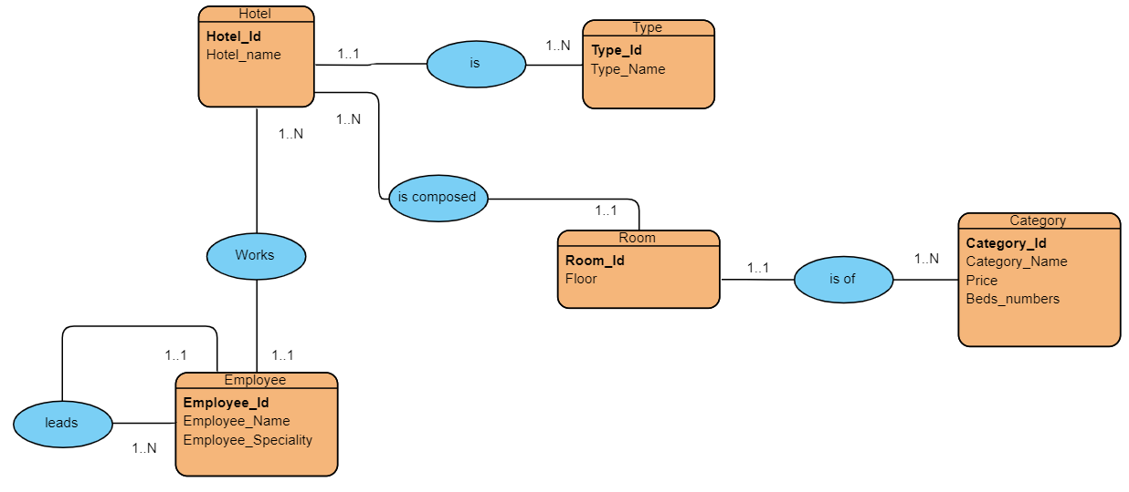
OBJECTIVES
Entity relationship model

Slide 5
INSTRUCTIONS
Convert the entity relationship model to a relational diagram

Slide 6
Relational diagram
Employee (Employee_id, Employee_name, Emplyee_speciality, #Hotel_id, #Director_id)
Hotel (Hotel_id, Hotel_name, #Type_id)
Type (Type_id, Type_name)
Room (Room_id, Floor, #Hotel_id, #Category_id)
Categoty (Categoty_id, Categoty_name, Price, Beds_Numbers)

